Slide 1

ANALYSIS OF BANK DATA
Phase 2 - Data Cleaning, Transformation & Visualization
Group Number : 02
Section Number : 004

Slide 2





Team Introduction
Team Members:
Aesha Rathod
Isha Dadhuk
Jasleen Kour Chibber
Kunal Vaghela
Tanveer Kaur

Slide 3
Background / Motivation
A bank is a financial corporation that offers a variety of services to its customers. These services often include deposit accounts, loans, credit cards, and other financial items.
Bank statistics can be analyzed to identify financial trends and guide decision-making.
It provide significant insights into the financial industry, assist banks in managing risk and preventing fraud, and inform the development of new products and services that better serve clients.

Slide 4
Problem Statement
The Portuguese bank dataset is a real-life dataset that contains information on direct marketing campaigns of a Portuguese banking institution. The problem statement of the dataset is to predict whether a client will subscribe to a term deposit (binary classification) based on a set of demographic, economic, and social indicators.
The dataset contains 21 input variables, including the client's age, job, education, marital status, housing, loan status, etc. The output variable is a binary variable that indicates whether the client has subscribed to a term deposit or not.

Slide 5
Project Proposal
The aim of this project is to develop a predictive model that can accurately predict whether a client will subscribe to a term deposit or not, based on a set of demographic, economic, and social indicators.

Slide 6
Analysis Questions
How do customer demographics (such as age, income, or education level) impact their financial behavior?
What is the overall response rate for the marketing campaign?
Are customers with certain job types more likely to subscribe to the bank's term deposit?
How does the time of day or month of contact affect the likelihood of subscription?

Slide 7
Data set description
The Bank dataset is a collection of data related to a direct marketing campaign of a Portuguese bank institution.
The dataset contains 41,188 instances and 20 attributes including demographic information, financial information, and details about the campaign. The dataset was obtained from the UCI Machine Learning Repository.
The dataset has been used for various machine learning tasks such as classification, clustering, and prediction.

Slide 8
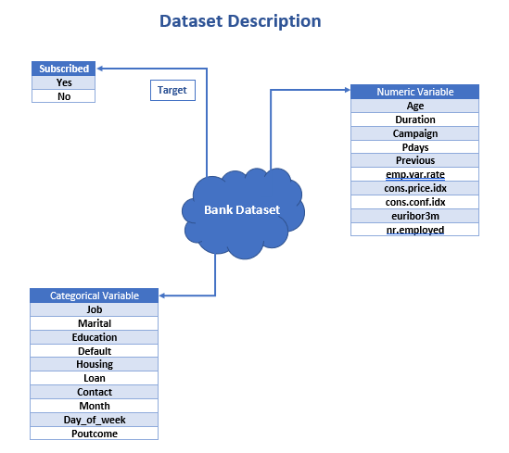

Slide 9
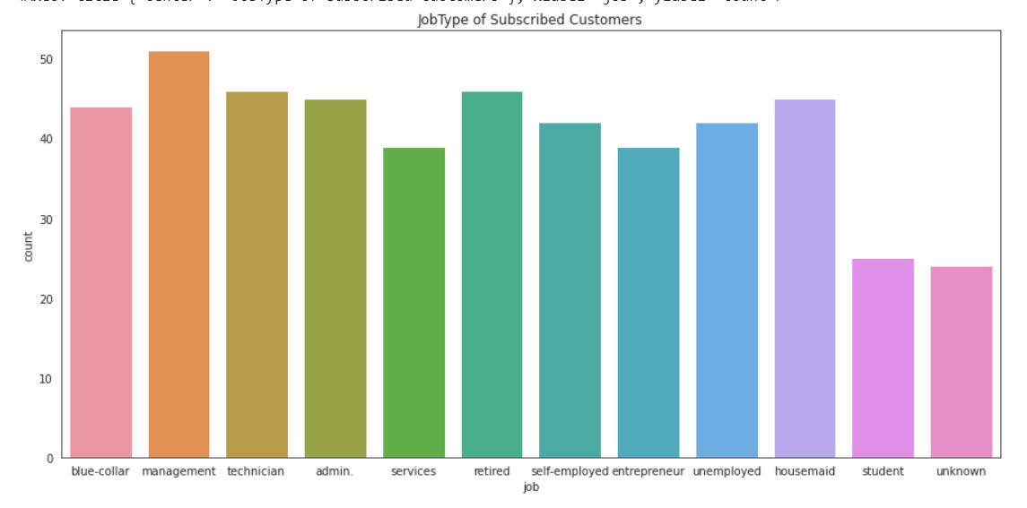
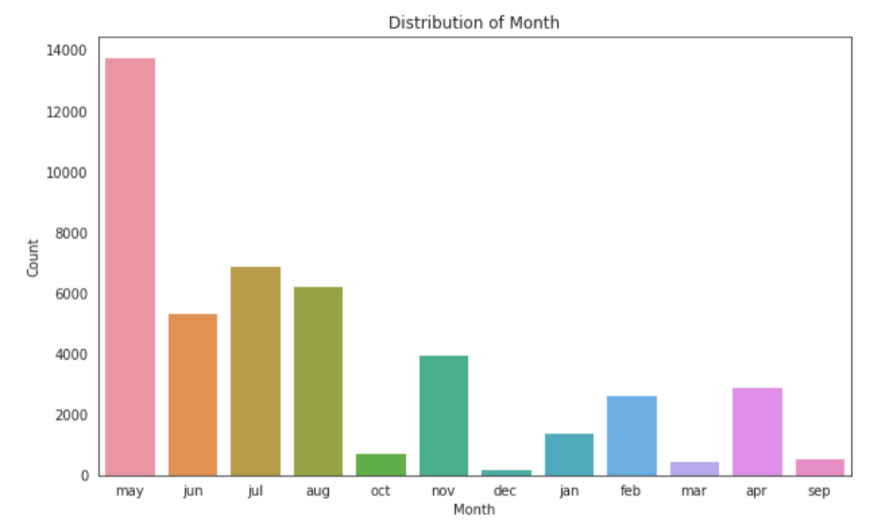
EDA - Visualization

Slide 10
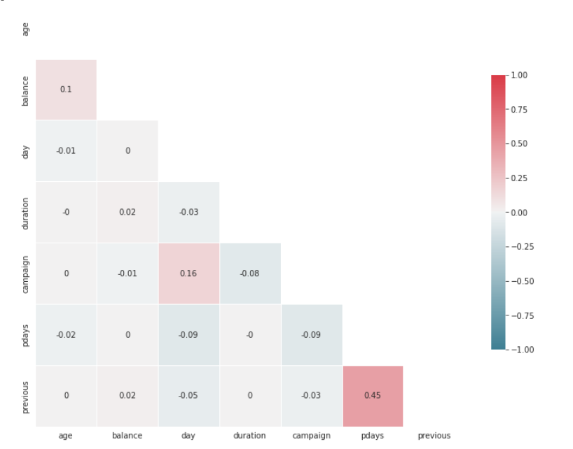
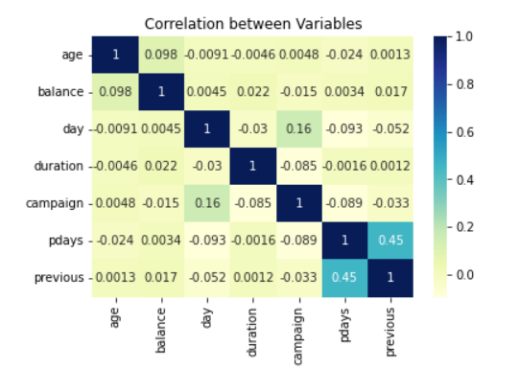
EDA - Visualization

Slide 11
Data Cleaning
The Portuguese Bank Marketing dataset contains missing values and categorical variables.
Missing values can be handled by imputation or deletion.
Categorical variables need to be encoded for analysis.
Outliers need to be identified and addressed.
The cleaned dataset should be checked for consistency.
e.g. Balance is in minus then removed, If above 60 age is removed.
Removed unused columns e.g. 'default', 'loan', 'contact', 'day’.

Slide 12
Data Transformation
Data transformation may or may not be needed in the Portuguese Bank Marketing dataset, depending on the specific analysis or modeling task.
Data transformation refers to the process of converting the original data into a different format that better suits the requirements of the analysis or modeling task. It can include tasks such as scaling, normalization, or log transformation.

Slide 13
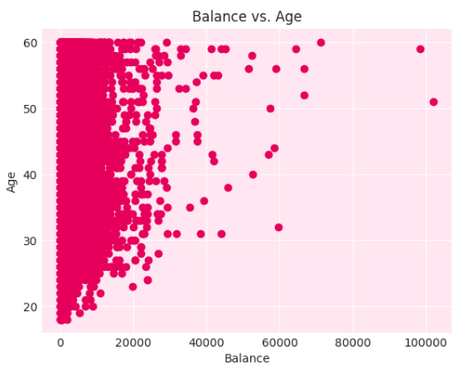
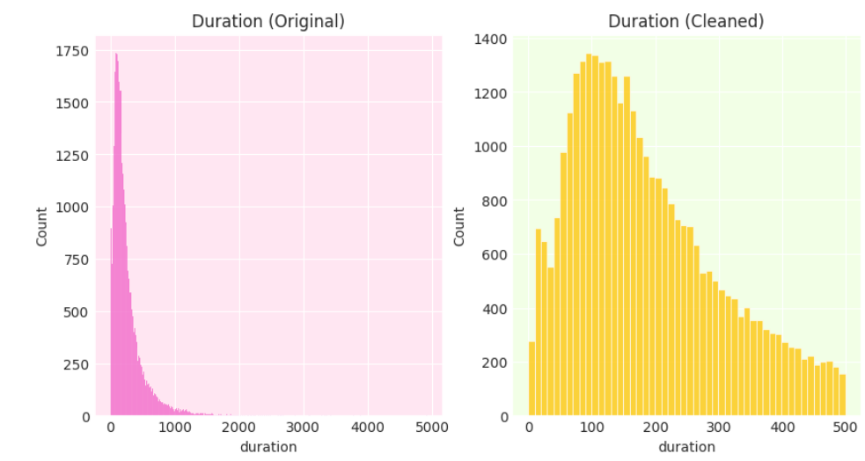
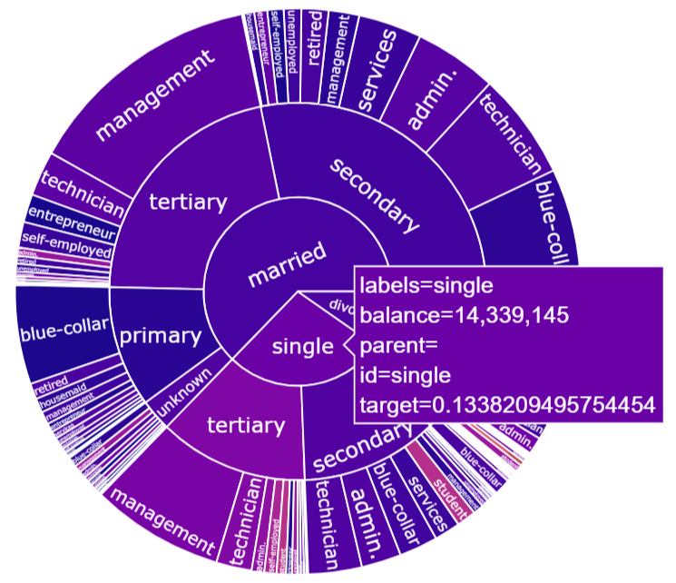
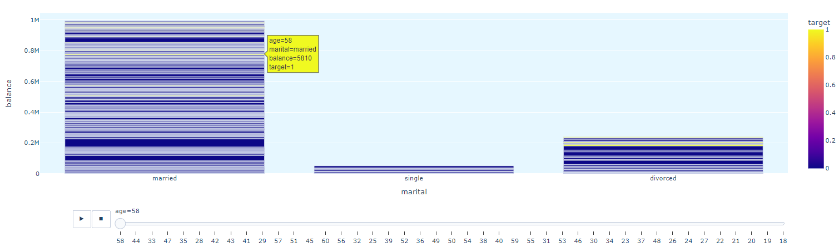
Data Visualization

Slide 14
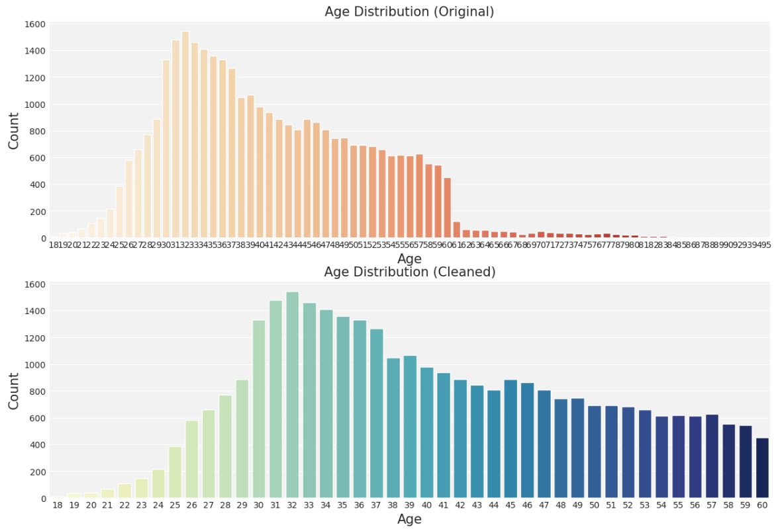
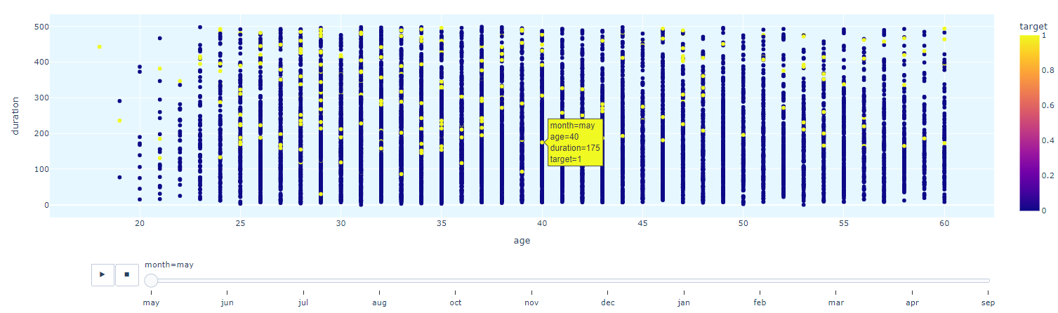
Data Visualization

Slide 15
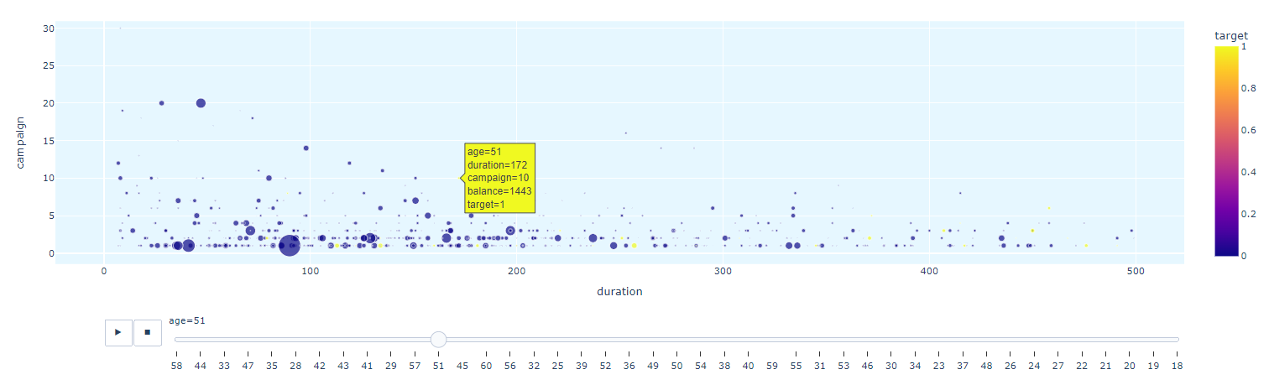
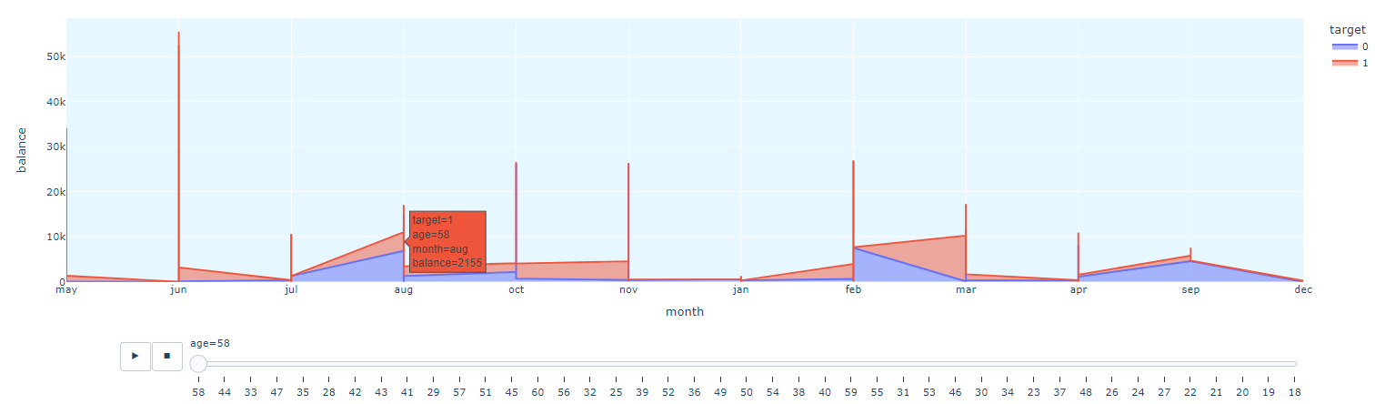
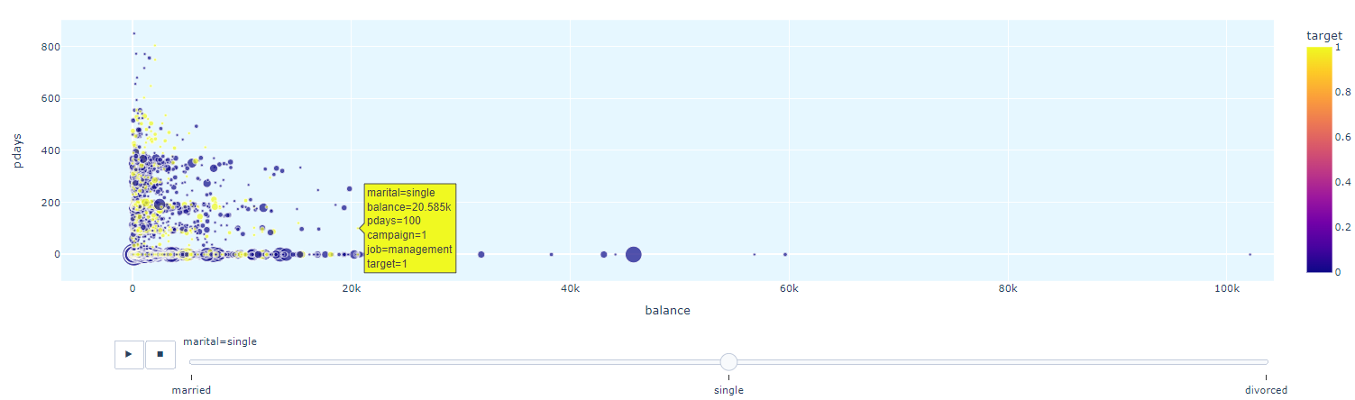

Slide 16
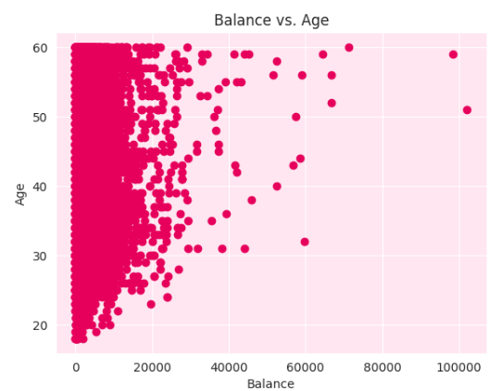
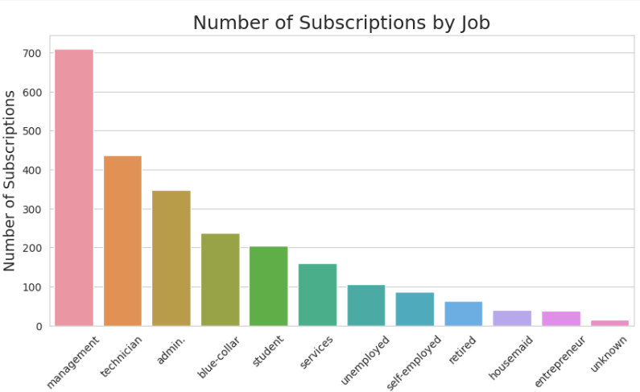
Analysis questions
1. How do customer demographics (such as age, income, or education level) impact their financial behavior?
2.Are customers with certain job types more likely to subscribe to the bank's term deposit?

Slide 17
References
Dataset: https://archive.ics.uci.edu/ml/datasets/bank+marketing
W3School: https://www.w3schools.com/python/matplotlib_intro.asp
Seaborn: https://seaborn.pydata.org/tutorial/introduction.html
GitHub Link of project
GitHub: Phase2-CleaningTransformationVisualization

